Slide 1
Database Security
Professor Dr. Mohammad Abu Yousuf
yousuf@juniv.edu

Slide 2
Introduction
Security violations and attacks are increasing globally at an annual average rate of 20%.
You serve as a database administrator to enforce security policies. Responsibilities can be:
Design and implement a new DB security policy.
Enforce a stringent security policy.
Implement functional specification of a module, i.e. encrypt the stored data, replace sensitive data using the data masking pack.

Slide 3
Introduction
Security measures
Prevent physical access to the servers where the data resided.
Operating systems require authentication of the identity of computer users.
Implement security models that enforce security measures.
DBA should manage databases and implement security policies to protect the data (assets).

Slide 4
Security Objectives
Prevent/detect improper
Disclosure of information
Secrecy
Prevent/detect
Improper modification
of information
Integrity
Availability
Prevent/detect improper
Denial of access to services
A denial-of-service attack is a security event that occurs when an attacker takes action that prevents legitimate users from accessing targeted computer systems, devices or other network resources.

Slide 5
Security
Database security: degree to which data is fully protected from tampering or unauthorized acts.
Comprises information system and information security concepts

Slide 6
Policy
Organizational policy
Information systems policy

Slide 7
Information Systems
Wise decisions require:
Accurate and timely information
Information integrity
Information system: comprised of components working together to produce and generate accurate information
Categorized based on usage: low-level, mid-level and high-level
Notes:
Business successes ← wise decision ← accurate and timely info ← data integrity and process of data

Slide 8
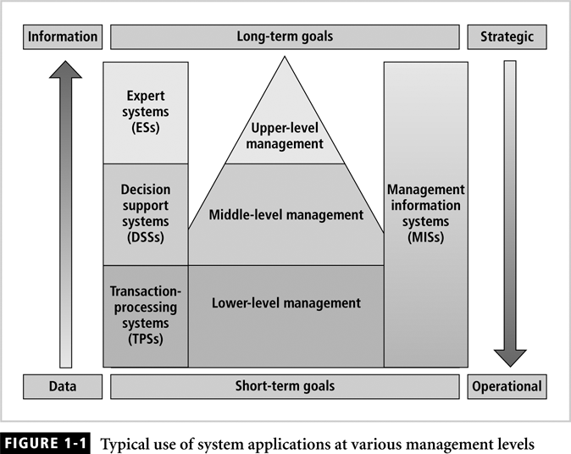
Information Systems (continued)

Slide 9
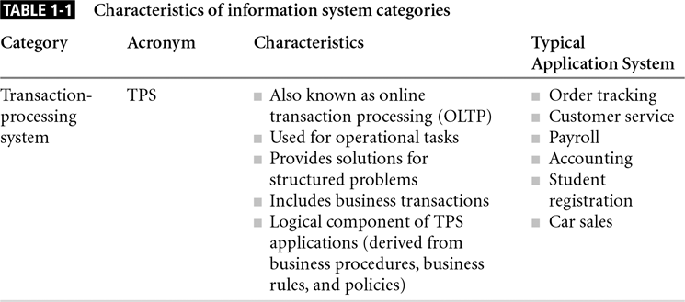
Information Systems (continued)

Slide 10
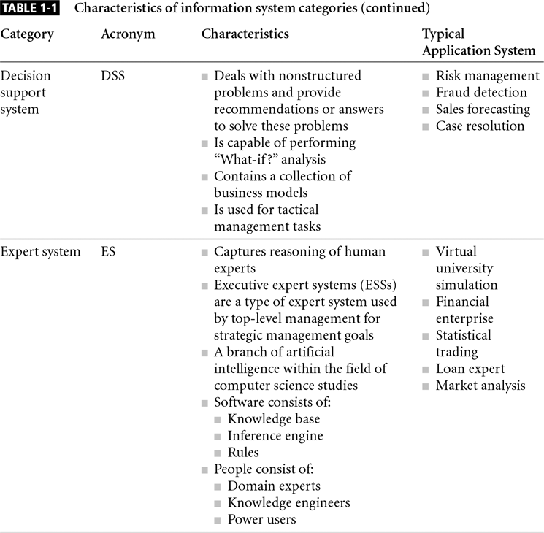
Information Systems (continued)

Slide 11
Information Systems (continued)
Information system components include:
Data
Procedures
Hardware
Software
Network
People

Slide 12
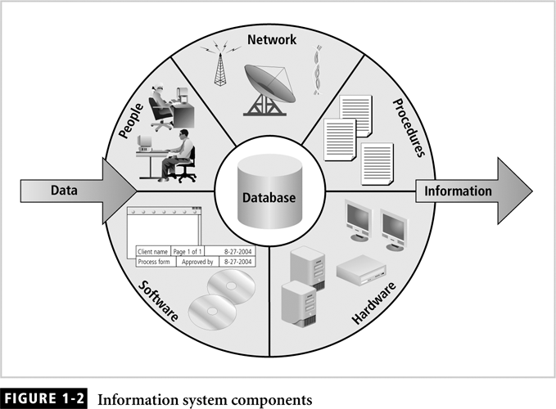
Information Systems (continued)

Slide 13
Databases
Collection of
interrelated data and
set of programs to access the data
Convenient and efficient processing of data

Slide 14
Database Management
Essential to success of information system
DBMS functionalities:
Organize data
Store and retrieve data efficiently
Manipulate data (update and delete)
Enforce referential integrity and consistency
Enforce and implement data security policies and procedures
Back up, recover, and restore data

Slide 15
Database Management (continued)
DBMS components include:
Data
Hardware
Software
Networks
Procedures
Database servers

Slide 16
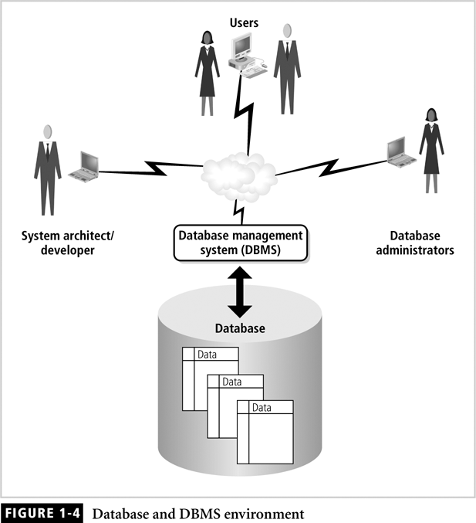
Database Management (continued)

Slide 17
Basic Security Concepts
The objectives of data security can be divided into:
Confidentiality or Secrecy of data
Integrity of data
Availability of data

Slide 18
Confidentiality (Secrecy)
Need to ensure that confidential data is only available to correct people.
Need to ensure that entire database is secured from external and internal system breaches.
Need to provide for reporting on who has accessed what data and what they have done with it.
Protected through the use of authentication and access control.

Slide 19
Confidentiality (continued)
Addresses two aspects of security:
Prevention of unauthorized access
Information disclosure based on classification
Classify company information into levels:
Each level has its own security measures
Usually based on degree of confidentiality necessary to protect information

Slide 20
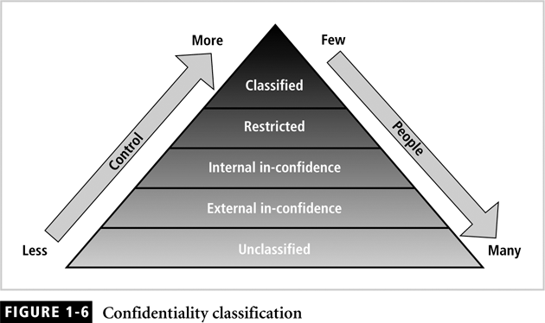
Confidentiality (continued)

Slide 21
Privacy vs. Confidentiality
Privacy is sometimes mixed with confidentiality but there is a difference.
Confidentiality: withholding data access.
Privacy: Obtain and record the consents of users to disclose information. The data should be used only for the purpose sanctioned by the users and not misused for other purposes.

Slide 22
Integrity
refers to the prevention of unauthorized and improper data modification.
Refers to the reliability, accuracy and consistency of the data stored within and retrieve from the database.
Protected by preventing both unauthorized and authorized modifications whether accidental or deliberate, that might cause the database storage or retrieval to be unreliable and inconsistent.

Slide 23
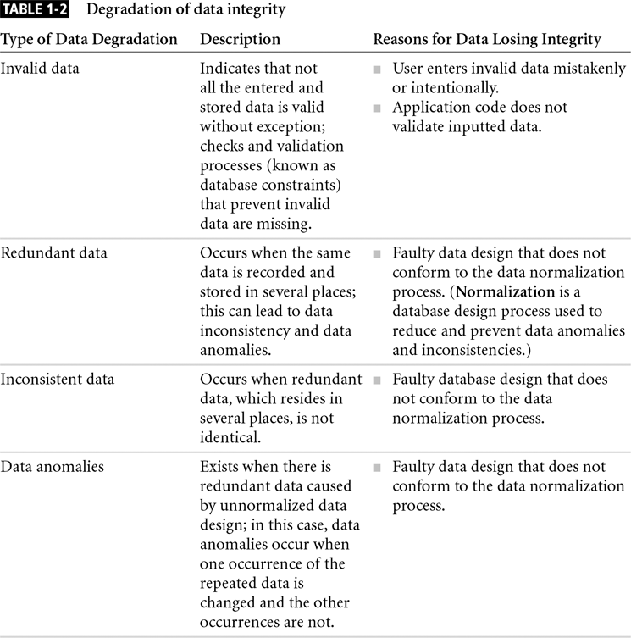
Integrity (continued)

Slide 24
Integrity (continued)

Slide 25
Availability
Data needs to be available at all necessary times
Data needs to be available to only the appropriate users
Need to be able to track who has access to and who has accessed what data

Slide 26
Availability
Identify those things that pose a threat to the availability of the database.
Assess the level of threat and plan an intervention.
Common potential threats:
Hardware failure
Software failure
Disaster
Intrusion etc.

Slide 27
Examples of Security concern
Database of a Payroll system.
Secrecy: Salaries should not be disclosed.
Integrity: Preventing an employee to change his/her salary.
Availability: Timely salary.

Slide 28
Example of Security concern
Database of a Web site of an airline company.
Secrecy: Customer reservation to be available to the customers only.
Integrity: It should not be arbitrarily modified.
Availability: Flight information and reservation information to be available always.

Slide 29
Secrecy, Integrity, Availability
They co-exists in every information system.
Relative importance differs from system to system
High integrity is needed for both military and commercial sectors.
Secrecy and availability requirements are more stringent in military sector than that of commercial sectors.

Slide 30
Security Policy
Purpose is to elaborate the three generic security objectives in the context of a particular system.
It defines the guidelines to achieve the three security objectives.
Law of the land may be mentioned for breach of security rules by an individual.
It should be determined by the organization itself rather than by regulatory agency.

Slide 31
Database Security
Database Security:
A set of established procedure, standard, policies and tools that is used to protect data from theft, misuse and unwanted intrusion, activities and attacks.
It deals with the permission and access to the data structure and the data contained within it.

Slide 32
Database Security (Continued)
Enforce security at all database levels.
Security access point: place where database security must be protected and applied.
Data requires highest level of protection; data access point must be small

Slide 33
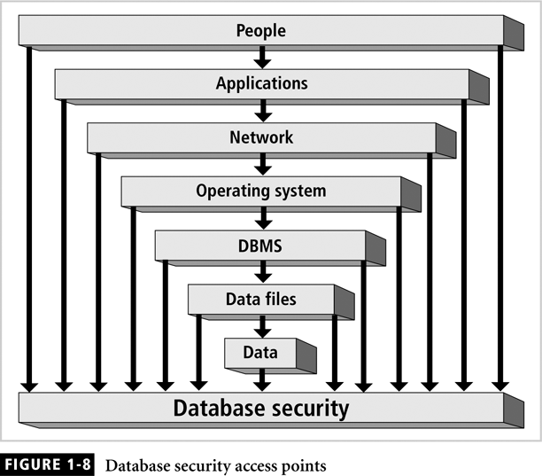
Database Security (Continued)

Slide 34
Database Security (Continued)
Reducing access point size reduces security risks
Security gaps: points at which security is missing.
Vulnerabilities: twists in the system that can become threats.
Threat: security risk that can become a system breach

Slide 35
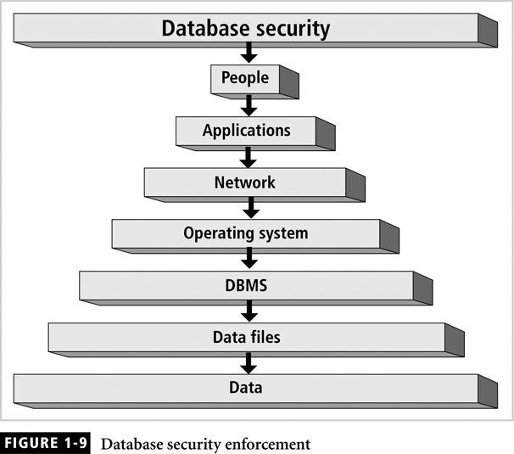
Database Security (continued)
Notes:
People:

Slide 36
Database Security (continued)
People: individuals who have been granted privileges and permissions to access applications, networks, servers, databases, data files and data.
Applications: application design and implementation, which includes privileges and permissions granted to people. Be cautious because too loose permission results in violation of data access, and too strict permission compromises availability.
Network is the most sensitive security access point. Use best effort to protect the network.

Slide 37
Database Security (continued)
Operating system: the authentication to the system and the gateway to the data.
DBMS: logical structure of the database, include memory, executables, and other binaries.
Data files: to be protected through the use of permissions and encryption.
Data: need to enforce data integrity, and necessary privileges.

Slide 38
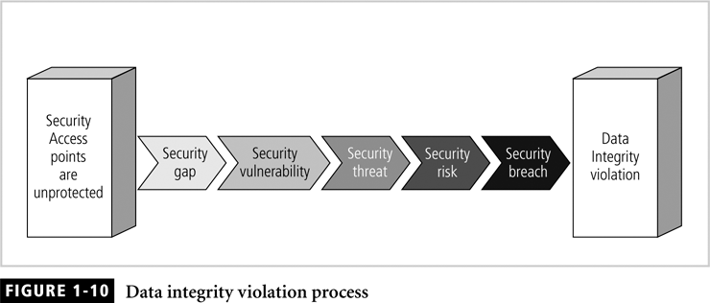
Database Security (continued)

Slide 39
Database Security Levels
Relational database: collection of related data files
Data file: collection of related tables
Table: collection of related rows (records)
Row: collection of related columns (fields)

Slide 40
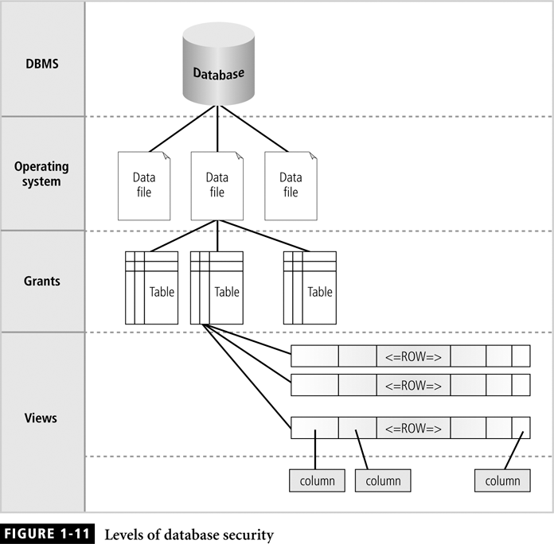
Database Security Levels (continued)
By database management system through user accounts and password
Through file permission
Schema owners/security administrator grant or revoke privileges

Slide 41
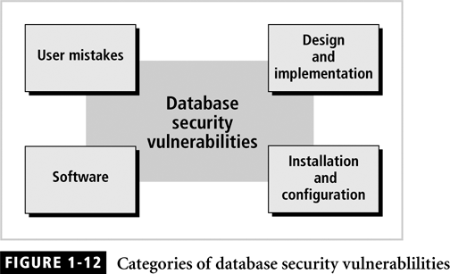
Threats to Databases
Security vulnerability: a weakness in any information system component

Slide 42
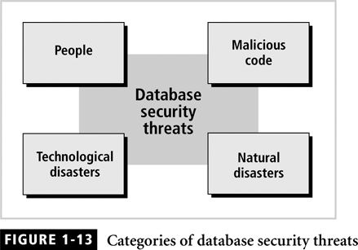
Threats to Databases (Continued)
Security threat: a security violation or attack that can happen any time because of a security vulnerability.

Slide 43
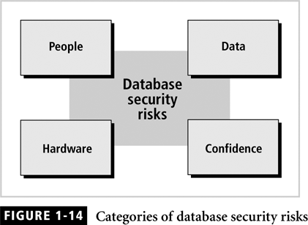
Threats to Databases (Continued)
Security risk: a known security gap left open.

Slide 44
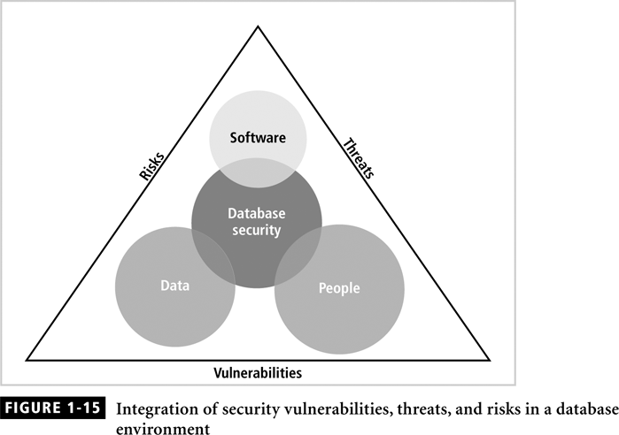
Threats to Databases (Continued)

Slide 45
Prevention, Detection & Tolerance
The objective of data security can be approached in two distinct and mutually supportive, ways:
Prevention: ensures that security breaches can not occur. System examines every action and checks its with the security policy before allowing it to occur.
Detection: ensures that sufficient history of the activity in the system is recorded in an audit trail so that a security breach can be detected after the fact-auditing.

Slide 46
Prevention, Detection & Tolerance
Tolerance – a 3rd technique
In which the potential for some security breaches is tolerated because either these breaches are too expensive to prevent or likelihood of its occurrence is extremely low.
Every practical system tolerates some degree of risk to potential security breaches.

Slide 47
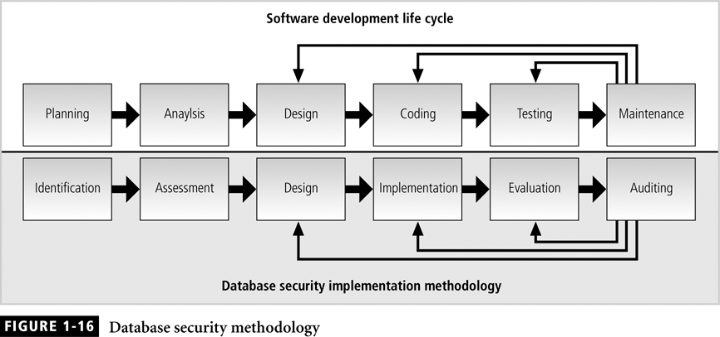
Database Security Methodology
Notes:
Identification: investigate resources required and policies to be adopted
Assessment: analysis of vulnerabilities, threats, and risks
Design: results in a blueprint of the adopted security model that is used to enforce security
Implementation: code is developed or tools are purchased to implement.
Evaluation: test your system against typical software attacks, hardware failures, natural disasters, and human errors.
Auditing: security audits should be performed periodically.

Slide 48
Summary
Security: level and degree of being free from danger and threats
Database security: degree to which data is fully protected from unauthorized tampering
Information systems: backbone of day-to-day company operations

Slide 49
Summary (continued)
DBMS: programs to manage a database
C.I.A triangle:
Confidentiality
Integrity
Availability
Secure access points
Security vulnerabilities, threats and risks
Information security architecture
Model for protecting logical and physical assets
Company’s implementation of a C.I.A. triangle
Enforce security at all levels of the database

Slide 50
Access Controls in Current Systems

Slide 51
Introduction
“Access control” is where security engineering meets computer science.
Its function is to control which (active) subject have access to a which (passive) object with some specific access operation.
subject
Access
Operation
object

Slide 52
Introduction
The purpose of access controls is to ensure that a user is only permitted to perform those operations on the database for which that user is authorized.
Protects against accidental and malicious threats by regulating the read, write and execution of data and programs.

Slide 53
Introduction
Authentication typically requires the user to supply his or her claimed identity (e.g., user name, operator number, etc.) along with a password or some other authentication token.
Authentication may be performed by the Operating System, the Database Management System, a special Authentication Server, or some combination thereof.

Slide 54
Access Controls in Current Systems
How to specify access control?

Slide 55
How to specify access control?
Access control components:
- Access control policy: specifies the
authorized accesses of a system
- Access control mechanism: implements
and enforces the policy

Slide 56
How to specify access control?
Access Control Policies
Discretionary Access Control (DAC)
Mandatory Access Control (MAC)
Role-Based Access Control (RBAC)

Slide 57
Modes of Access Control
AC can be imposed at various degrees of granularity in the system.
The entire Database.
Some Collection of relations(Tables)
One relation(Table).
Some columns of one relation
Some rows of one relation.
Some columns of some rows of one relation.

Slide 58
Modes of Access Control
Subject: active entity that requests access to an object
- e.g., user or program
Object: passive entity accessed by a subject
- e.g., record, relation, file
Access right (privileges): how a subject is allowed to access an object
- e.g., subject s can read object o

Slide 59
Modes of Access Control
Access Control Modes are expressed in terms of basic SQL statements:
SELECT can be specified by relation by relation basis. Finer granularity of authorization can be provided by views:
INSERT can be specified by relation by relation basis.
DELETE can be specified by relation by relation basis.
UPDATE can be restricted to certain columns of a relation.

Slide 60
Discretionary Access Control
Access to data objects (files, directories, etc.) is permitted based on the identity of users.
Explicit access rules that establish who can, or cannot, execute which actions on which resources.
Discretionary: users can be given the ability of passing on their privileges to other users, where granting and revocation of privileges is regulated by an administrative policy.

Slide 61
Discretionary Access Control
is a type of access control in which a user has complete control over all the programs(subject) it owns.
Owner of the subject determines the access level of that subject.
User Authentication: Username / Password /biometrics
Authorized to perform specific operations on the Database.
Managed by Granting / Revoking various kinds of privileges.

Slide 62
Mandatory Access Control
is a type of access control in which only the administrator manages the access controls.
System determines the access level.
The administrator defines the usage and access policy, which cannot be modified or changed by users, and the policy will indicate who has access to which programs and files.
MAC is most often used in systems where priority is placed on confidentiality.

Slide 63
Difference between DAC and MAC
The main difference between them is in how they provide access to users.
With MAC, admins creates a set of levels and each user is linked with a specific access level. He can access all the resources that are not greater than his access level.
In contrast, each resource in DAC has a list of users who can access it. DAC provides access by identity of the user and not by permission level.

Slide 64
Discretionary Access Control
Discretionary Access Control (DAC)
Access Control Matrix Model
Implementation of the Access Matrix
Vulnerabilities of the Discretionary Policies
Additional features of DAC

Slide 65
Discretionary Access Control
Access control matrix
Describes protection state precisely
Matrix describing rights of subjects
State transitions change elements of matrix
State of protection system
Describes current settings, values of system relevant to protection

Slide 66
Discretionary Access Control
Discretionary Access Control
Access Control Matrix Model
Implementation of the Access Matrix
Vulnerabilities of the Discretionary Policies
Additional features of DAC

Slide 67
Access Control Matrix Model
Access control matrix
Firstly identify the objects, subjects and actions.
Describes the protection state of a system.
State of the system is defined by a triple (S, O, A)
S is the set of subject,
O is the set of objects,
A is the access matrix
Elements indicate the access rights that subjects have on objects
Entry A[s, o] of access control matrix is the privilege of s on o
Notes:
S is the set of subjects, o is the set of objects and A is the access matrix, where rows correspond to subjects, columns correspond to objects, and entry A
OS objects could be files, directories, programs
DB objects could be relations, views, stored procedures,
Subjects could be objects, executable code and stored procedures
Subjects can create subjects, the creator subject acquires control privileges on the created processes
Privileges could include read, write, execute, actions, and ownership(property of objects by subjects), and control (to model father-childeren relationship between processes).

Slide 68
Description
objects (entities)
o₁ … o_{m} s₁ … s_{n}
Subjects S = { s₁,…,s_{n} }
Objects O = { o₁,…,o_{m} }
Rights R = { r₁,…,r_{k} }
Entries A[s_{i}, o_{j}] ⊆ R
A[s_{i}, o_{j}] = { r_{x}, …, r_{y} } means subject s_{i} has rights r_{x}, …, r_{y} over object o_{j}
s₁
s₂
…
s_{n}
subjects

Slide 69
Access Control
Discretionary Access Control
Access Matrix Model
Implementation of the Access Control Matrix
Vulnerabilities of the Discretionary Policies
Additional features of DAC

Slide 70
ACM Implementation
ACM is an abstract model
Rights may vary depending on the object involved
ACM is implemented primarily in three ways
Authorization Table
Capabilities (rows)
Access control lists (columns)

Slide 71
Authorization Table
Three columns: subjects, actions, objects
Generally used in DBMS systems

Slide 72
Access Control List (ACL)
Matrix is stored by column.
Each object is associated with a list
Indicate for each subject the actions that the subject can exercise on the object

Slide 73
Access Control List (ACL)

Slide 74
Capability List
Matrix is stored by row
Each user is associated with a capability list
Indicating for each object the access that the user is allow to exercise on the object

Slide 75
Capability List

Slide 76
ACLs vs Capability List
Immediate to check the authorization holding on an object with ACLs. (subject?)
Immediate to determine the privileges of a subject with Capability lists. (object?)
Distributed system,
authenticate once, access various servers
choose which one?
Limited number of groups of users, small bit vectors, authorization specified by owner.
Which one?

Slide 77
Basic Operations in Access Control
Grant permissions
Inserting values in the matrix’s entries
Revoke permissions
Remove values from the matrix’s entries
Check permissions
Verifying whether the entry related to a subject s and an object o contains a given access mode

Slide 78
Access Control
Discretionary Access Control
Access Matrix Model
State of Protection System
Implementation of the Access Matrix
Vulnerabilities of the Discretionary Policies
Additional features of DAC

Slide 79
Vulnerabilities of the Discretionary Policies
No control on the flow the information
Malicious code, i.e., Trojan horse

Slide 80
Example
Vicky, a top-level manager
A file Market on the new products release
John, subordinate of Vicky
A file called “Stolen”
An application with two hidden operations
Read operation on file Market
Write operation on file Stolen

Slide 81
Example (cond)

Slide 82
Example (cond)
Restriction should be enforced on the operations that processes themselves can execute.
Mandatory policies provide a way to enforce information flow control through the use of labels

Slide 83
Access Control
Discretionary Access Control
Access Matrix Model
State of Protection System
Implementation of the Access Matrix
Vulnerabilities of the Discretionary Policies
Additional features of DAC

Slide 84
DAC – additional features and recent trends
Flexibility is enhanced by supporting different kinds of permissions
Positive vs. negative
Implicit vs. explicit
Content-based

Slide 85
Positive and Negative Permissions
Positive permissions → Give access
Negative permissions → Deny access
Useful to specify exceptions to a given policy and to enforce stricter control on particular crucial data items

Slide 86
Implicit and Explicit Permissions
Some models support implicit permissions
Implicit permissions can be derived:
by a set of propagation rules exploiting the subject, object, and privilege hierarchies
by a set of user-defined derivation rules

Slide 87
Derivation Rules: Example
Ann can read file F1 from a table if Bob has an explicit denial for this access.
Tom has on file F2 all the permissions that Bob has.
Derivation rules are a way to concisely express a set of security requirements.

Slide 88
Derivation Rules
Derivation rules are often expressed according to logic programming
Several research efforts have been carried out to compare the expressive power of such languages
We need languages based on SQL and/or XML

Slide 89
Content-based Permissions
Content-based access control conditions the access to a given object based on its content
This type of permissions are mainly relevant for database systems
As an example, in a RDBMS supporting content-based access control it is possible to authorize a subject to access information only of those employees whose salary is not greater than 30K

Slide 90
Content-based Permissions
Two most common approaches to enforce content-based access control in a DBMS are done:
by associating a predicate (or a Boolean combination of predicates) with the permission
by defining a view which selects the objects whose content satisfies a given condition, and then granting the permission on the view instead of on the basic objects

Slide 91
Discretionary Access Control
Data Dependent Access Control
Database Access Controls are often data dependent.
Some users may be allowed to see the salary up to Tk.20000
A manager may be allowed to see the salary of the employees of his/her own department.
Three techniques:
Security through Views
Query modification
Grant and Revoke

Slide 92
Discretionary Access Control
View based Access Controls
A view is a virtual relation (table)
The DB stores its definition and materializes the view as needed.
Useful mechanism for specifying data-dependent authorization for data retrieval.
Example: Employee Table
COLUMNS :
EMPID, ENAME,SALARY,MANAGER, DEPTNO

Slide 93
Discretionary Access Control
View:
Views provide a valuable tool in enforcing security policies.
A view is a table whose rows are not explicitly stored in the database but are computed as needed from a view definition.

Slide 94
Discretionary Access Control
View based Access Controls (EMPLOYEE TABLE)
EMPID | ENAME | SALARY | MANAGER | DEPTNO
0001 | Smith | 10000 | Bretlee | Sales
0002 | Jones | 12000 | Bretlee | Sales
0003 | Baker | 15000 | Milton | Production
0004 | Adams | 20000 | Bretlee | Sales
0005 | Hares | 25000 | Milton | Production
0006 | Milton | 70000 | NULL | Production
0007 | Polard | 35000 | Bretlee | Sales
0008 | Bretlee | 60000 | NULL | Sales

Slide 95
Discretionary Access Control
View based Access Controls
Create a view for employee list of sales department:
CREATE VIEW EMP_SALES
AS SELECT EMPID,ENAME, SALARY,MANAGER FROM EMPLOYEE WHERE DEPTNO=‘Sales’;

Slide 96
Discretionary Access Control
View based Access Controls(EMP_Sale view)
EMPID | ENAME | SALARY | MANAGER
0001 | Smith | 10000 | Bretlee
0002 | Jones | 12000 | Bretlee
0004 | Adams | 20000 | Bretlee
0007 | Polard | 35000 | Bretlee
0008 | Bretlee | 60000 | NULL
EMPID | ENAME | SALARY | MANAGER | DEPTNO
0001 | Smith | 10000 | Bretlee | Sales
0002 | Jones | 12000 | Bretlee | Sales
0003 | Baker | 15000 | Milton | Production
0004 | Adams | 20000 | Bretlee | Sales
0005 | Hares | 25000 | Milton | Production
0006 | Milton | 70000 | NULL | Production
0007 | Polard | 35000 | Bretlee | Sales
0008 | Bretlee | 60000 | NULL | Sales

Slide 97
Discretionary Access Control
View based Access Controls for Statistical information
CREATE VIEW AVSAL(DEPT,AVG)
AS SELECT DEPTNO, AVG(SALARY)
FROM EMPLOYEE GROUP BY DEPTNO;
DEPTNO | AV(SALARY)
Sales | 35,000
Production | 36,000

Slide 98
Discretionary Access Control
Query Modification
Another technique for enforcing data-dependent access controls for retrieval.
A privilege allows a user to access some data object in a certain manner (e.g., to read or to modify).
SQL-92 supports discretionary access control through GRANT and REVOKE commands.

Slide 99
Discretionary Access Control
Query Modification
A query submitted by the user is modified to include further restrictions as determined by the DBA.
Example: GRANT SELECT ON EMPLOYEE
TO Thomas
WHERE DEPTNO=“Sales”;

Slide 100
Discretionary Access Control
Query Modification
If Thomas executes the query:
SELECT * FROM EMPLOYEE;
Data from entire EMPLOYEE table would be returned.
But if the GRANT privilege is applied, DBMS will automatically modify the query to retrieve data only from Sales Department.

Slide 101
Discretionary Access Control
Granting and revocation of Access
Granting Access:
GRANT privilege
[ON relation]
TO users
[WITH GRANT OPTION]
Revocation of Access:
REVOKE privilege
[ON relation]
FROM users
[WITH GRANT OPTION]

Slide 102
Non-cascading Revoke
B
E
A
D
C
F
A revokes D’s privileges
E
B
A
C
F

Slide 103
Cascading Revoke
B
E
A
D
C
F
B
A
C

Slide 104
If you use RESTRICT keyword, the privilege will be revoked only from the specified user. If the specified user granted had the WITH GRANT OPTION and granted the same privilege to other users, they will retain the privilege.
If you use CASCADE, it will revoke the privilege and any dependent privileges as a result of your grant. A dependent privilege is one that could exist, if you granted the privilege that you're trying to revoke

Slide 105
Discretionary Access Control
Granting and Revocation of Access(Examples):
GRANT SELECT ON EMPLOYEE TO TOM;
GRANT SELECT,UPDATE(SALARY) ON EMPLOYEE TO TOM;
GRANT INSERT,DELETE ON EMPLOYEE TO TOM,RICK,HARRY;
GRANT SELECT ON EMPLOYEE TO TOM WITH GRANT OPTION;
GRANT DBA TO JILL WITH GRANT OPTION;

Slide 106
Discretionary Access Control
Granting and revocation of Access (Examples):
REVOKE SELECT ON EMPLOYEE FROM TOM;
REVOKE SELECT,UPDATE(SALARY) ON EMPLOYEE FROM TOM;
REVOKE INSERT,DELETE ON EMPLOYEE FROM TOM,RIK;

Slide 107
Discretionary Access Control
Granting and revocation of Access(Examples):
RIK: GRANT SELECT ON EMPLOYEE TO TOM;
RIK: REVOKE SELECT ON EMPLOYEE TO TOM;
RIK: GRANT SELECT ON EMPLOYEE TO TOM;
HARRY: GRANT SELECT ON EMPLOYEE TO TOM;
RIK: REVOKE SELECT ON EMPLOYEE TO TOM;
TOM continues to retain SELECT privilege due the grant by Harry.

Slide 108
Discretionary Access Control
Cascading Revocation(Example):
RIK: GRANT SELECT ON EMPLOYEE TO JOE WITH GRANT OPTION;
JOE: GRANT SELECT ON EMPLOYEE TO TOM;
RIK: REVOKE SELECT ON EMPLOYEE TO JOE;
RIK revokes SELECT privilege from JOE. Granting SELECT to TOM by JOE will be revoked also. This is cascading revocation.

Slide 109
Discretionary Access Control
Granting and revocation of Access(Example):
RIK: GRANT SELECT ON EMPLOYEE TO JOE WITH GRANT OPTION;
HARRY: GRANT SELECT ON EMPLOYEE TO JOE WITH GRANT OPTION;
JOE: GRANT SELECT ON EMPLOYEE TO TOM;
RIK: REVOKE SELECT ON EMPLOYEE FROM JOE;
RIK revokes SELECT privilege from JOE. JOE and TOM continue to retain the SELECT privilege due to the grant by Harry.

Slide 110
Limitations of DAC
Granting of access is under user control.
Users who possess a privilege with the grant option are free to grant it to whoever they choose to.
Serious limitations with respect to secrecy requirements

Slide 111
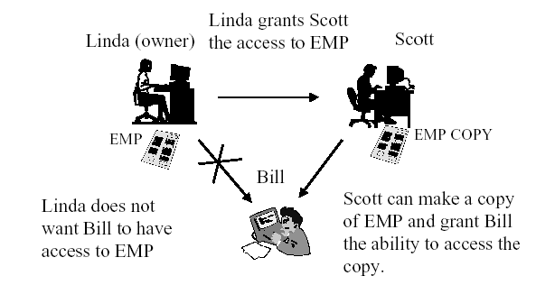
Limitations of DAC

Slide 112
Another Limitations of DAC (Example)
TOM: GRANT SELECT ON EMPLOYEE TO RIK;
No grant option is given to RIK
Still RIK can pass information to another user say HARRY
RIK can create a COPY-OF-EMPLOYEE RELATION and can grant privilege to others (Harry) on this relation(table).
Harry has access to all the information in the EMPLOYEE table.

Slide 113
Another Limitations of DAC (Example)
Suppose Rik is a trusted confident of Tom and would not deliberately subvert Tom’s intentions regarding EMPLOYEE table.
Rik uses a fancy text editor supplied to him by Harry.
This editor provides all editing needs that Rik needs.

Slide 114
Another Limitations of DAC (Example)
Harry has also programmed it to create COPY-OF-EMPLOYEE relation and execute the following grant operation.
RIK: GRANT SELECT ON COPY-OF-EMPLOYEE TO HARRY
Such S/W is said to be a Trojan Horse.

Slide 115
Hands-on Projects (10 minutes)
You are a security officer working for a medium-sized research company. You have been assigned to guard a back entrance checkpoint. One day, a well-known manager walks out with a box of papers. A day after you are summoned to the security office by your manager and the security director for questioning about the manager who had been terminated the day before. The manager had walked out with highly confidential information.
Outline briefly what types of security measures were violated and how to avoid those violations.
Describe how this incident may result in security violations.

Slide 116
Thank you !!

